Slide 1




Defining Classes
Classes, Fields, Constructors
Java OOP
Basics
SoftUni Team
Technical Trainers
Software University
http://softuni.bg

Slide 2

Table of Contents
Abstract Data Types
Defining Simple Classes
Methods and Properties
Constructors
Static Members

Slide 3
Questions
sli.do #java-fund

Slide 4

Abstract Data Type
Hide Details from the Client

Slide 5
Abstract Data Type
Data type whose representation is hidden from the client
String ADT – indexed sequence of chars:
String()
int length()
char charAt(int index)
boolean isEmpty()
// many others…
ADTs are defined by their usage

Slide 6


Abstract Data Type (2)
You don't need to know the implementation to use an ADT
Dog:
Dog()
String getName()
void bark()
void sleep()
Computer:
Computer()
void turnOn()
void turnOff()
String getSpecs()

Slide 7

Defining Classes
Creating Class for an ADT

Slide 8
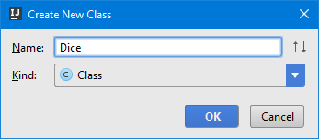
Defining Simple Classes
Class is a concrete implementation of an ADT
Classes provide structure for describing and creating objects
Keyword
Class name
class Dice {
…
}
Class in a separate file
Class body

Slide 9


Naming Classes
Classes should be PascalCase
Use descriptive nouns
Avoid abbreviations (except widely known, e.g. URL, HTTP, etc.)
class Dice { … }
class BankAccount { … }
class IntegerCalculator { … }
class TPMF { … }
class bankaccount { … }
class intcalc { … }

Slide 10
Class Members
Class is made up of state and behavior
Fields store state
Methods describe behaviour
class Dice {
int sides;
String type;
void roll(){ … }
}
Fields
Method

Slide 11
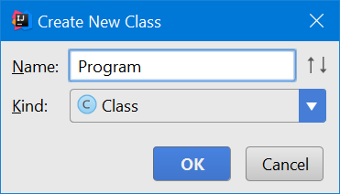
Creating an Object
A class can have many instances (objects)
class Program {
public static void main(String[] args) {
Dice diceD6 = new Dice();
Dice diceD8 = new Dice();
}
}
Application in a separate file
Variable stores a reference
Use the new keyword

Slide 12
Object Reference
Declaring a variable creates a reference in the stack
new keyword allocates memory on the heap
Dice diceD6 = new Dice();
Reference has a fixed size
Stack
Heap
type = null sides = 0
diceD6
(1540e19d)
State is kept in the heap

Slide 13
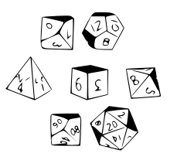

Classes vs. Objects
Classes provide structure for describing and creating objects
An object is a single instance of a class
Dice is…
Dice ADT
Dice (Class)
D6 Dice (Object)

Slide 14
Classes vs. Objects (2)
Classes
Objects
Object name
Class name
object diceD6
class Dice
type: String
sides: int
type = "six sided"
sides = 6
Class data
Object data
roll(…)
object diceD8
Class actions (methods)
type = "eight sided"
sides = 8

Slide 15
Class Data
Storing Data Inside a Class

Slide 16
Fields
Class fields have type and name
class Dice {
String type;
int sides;
int[] rollFrequency;
Person owner;
…
}
Fields can be of any type

Slide 17
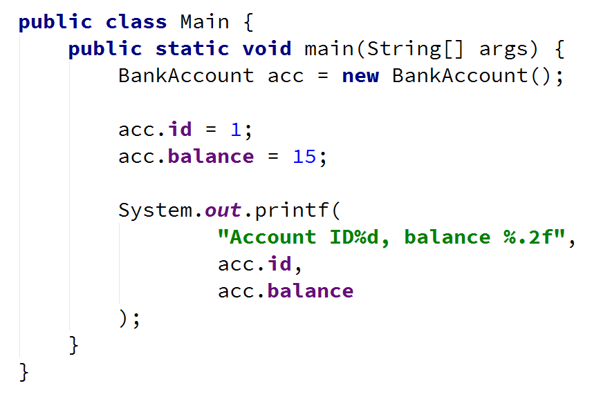
Problem: Define Class Bank Account
Create a class BankAccount
Ensure proper naming!
Class name
BankAccount
Class fields
+id:int
+balance:double
Class methods
(no actions)

Slide 18
Solution: Define Class Bank Account
public class BankAccount {
int id;
double balance;
}

Slide 19
Modifiers
Classes and class members have modifiers
Modifiers define visibility
Class modifier
public class Dice {
private int sides;
public void roll(int amount);
}
Fields should always be private!
Member modifier

Slide 20
Methods
Defining a Class' Behaviour

Slide 21
Methods
Store executable code (algorithm) that manipulate state
class Dice {
private int sides;
public int roll() {
Random rnd = new Random();
int rollResult = rnd.nextInt(this.sides) + 1; return rollResult;
}
}
this points to the current instance

Slide 22
Getters and Setters
Used to create accessors and mutators (getters and setters)
Field is hidden
class Dice {
private int sides;
public int getSides() {
return this.sides;
}
public void setSides(int sides) { this.sides = sides;
}
}
Getter provides access to field
Setter provide field change

Slide 23
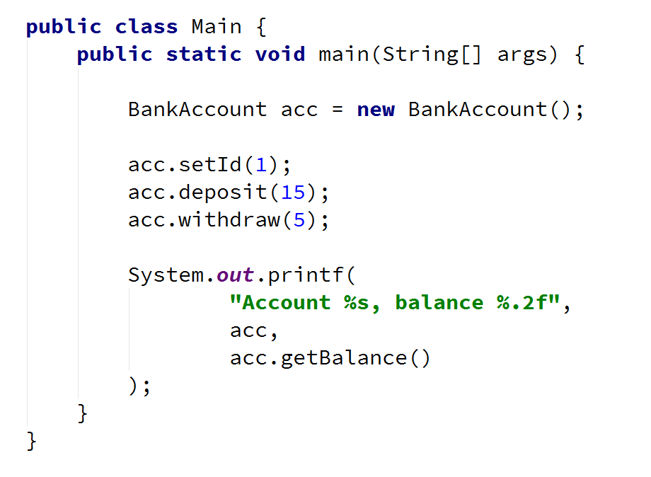
Problem: Getters and Setters
Create a class BankAccount
- == private
BankAccount
-id:int
-balance:double
+setId():void
+getBalance():double
+deposit(double amount):void
+withdraw(double amount):void
return type
Override toString()
+ == public

Slide 24
Solution: Getters and Setters
public class BankAccount {
private int id;
private double balance;
public void setId(int id) { this.id = id; }
public double getBalance() { return this.balance; }
public void deposit(double amount) { //TODO: }
public void withdraw(double amount) { //TODO: }
@Override
public String toString() { return "ID" + this.id; }
}

Slide 25
Problem: Test Client
Create a test client that tests your BankAccount class
Support commands:
Create {Id}
Deposit {Id} {Amount}
Withdraw {Id} {Amount}
Print {Id}
End
Create 1
Create 1
Deposit 1 20
Withdraw 1 30
Withdraw 1 10
Print 1
End
Exsisting account
Insufficient balance
Account already exists
Insufficient balance
Account ID1, balance 10.00
.2f
Check your solution here: https://judge.softuni.bg/Contests/Practice/Index/474#0

Slide 26
Solution: Test Client
Scanner scanner = new Scanner(System.in);
HashMap<Integer, BankAccount> accounts = new HashMap<>();
String command = scanner.nextLine();
while (!command.equals("End")) {
// TODO: Get command arguments (cmdArgs[])
switch (cmdType) {
case "Create": execCreate(cmdArgs, accounts); break;
case "Deposit": execDeposit(cmdArgs, accounts); break;
case "Withdraw": execWithdraw(cmdArgs, accounts); break;
case "Print": execPrint(cmdArgs, accounts); break;
}
}
Check your solution here: https://judge.softuni.bg/Contests/Practice/Index/474#0

Slide 27
Solution: Test Client (2)
// Account creation
int id = Integer.parseInt(cmdArgs[1]);
if (accounts.containsKey(id)) {
System.out.println("Account already exists");
} else {
BankAccount account = new BankAccount();
account.setId(id);
accounts.put(id, account);
}
// TODO: Implement other methods…
Check your solution here: https://judge.softuni.bg/Contests/Practice/Index/474#0

Slide 28

Defining Classes
Live Exercises in Class (Lab)

Slide 29

Constructors
Object Initialization

Slide 30
Constructors
Special methods, executed during object creation
class Dice {
int sides;
public Dice() {
this.sides = 6;
}
}
Overloading default constructor

Slide 31
Constructors (2)
You can have multiple constructors in the same class
class Dice {
int sides;
public Dice() {
this.sides = 6;
}
public Dice(int sides) {
this.sides = sides;
}
}
Constructor without parameters
Constructor with parameters

Slide 32
Object Initial State
Constructors set object's initial state
class Dice {
int sides;
int[] rollFrequency;
public Dice(int sides) {
this.sides = sides;
this.rollFrequency = new int[sides];
}
}
Always ensure correct state

Slide 33
Constructor Chaining
Constructors can call each other
Calls constructor with parameters
class Dice {
int sides;
public Dice() {
this(6);
}
public Dice(int sides) {
this.sides = sides;
}
}
6 should be declared in a final variable

Slide 34
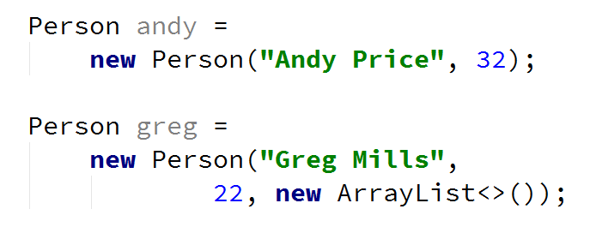
Problem: Define Person Class
Create a class Person
Person
-name:String
-age:int
-accounts:List<BankAccount>
+Person(String name, int age)
+Person(String name, int age, List<BankAccount> accounts)
+getBalance():double

Slide 35
Solution: Define Person Class
public Person(String name, int age) {
this.name = name;
this.age = age;
this.accounts = new ArrayList<>();
}
public Person(String name, int age, List<BankAccount> accs) {
this.name = name;
this.age = age;
this.accounts = accs;
}

Slide 36

Static Members
Members Common for the Class

Slide 37
Static Members
Static members are shared class-wide
class BankAccount {
private static int accountsCount;
public BankAccount() {
accountsCount++;
}
}

Slide 38
Static Members (2)
Static members are shared class-wide
class BankAccount {
private static double interestRate;
public static void setInterestRate(
double rate) {
interestRate = rate;
}
}

Slide 39
Accessing Static Members
Access static members through the class name
You don't need an instance
class Program {
public static void main(String[] args) {
BankAccount.setInterestRate(2.2);
}
}
Sets the rate for all bank accounts

Slide 40
Problem: Static Id and Rate
BankAccount
Create a class BankAccount
Support commands:
Create
Deposit {ID} {Amount}
SetInterest {Interest}
GetInterest {ID} {Years}
End
-id:int (starts from 1)
-balance:double
-interestRate:double (default: 0.02)
underline == static
+setInterest(double interest):void
+getInterest(int years):double
+deposit(double amount):void
Create
Deposit 1 20
GetInterest 1 10
End
Account ID1 Created
Deposited 20 to ID1
4.00
(20 * 0.02) * 10
Check your solution here: https://judge.softuni.bg/Contests/Practice/Index/474#1

Slide 41
Solution: Bank Account
public class BankAccount {
private final static double DEFAULT_INTEREST = 0.02;
private static double rate = DEFAULT_INTEREST;
private static int bankAccountsCount;
private int id;
private double balance;
// continue…
}
Check your solution here: https://judge.softuni.bg/Contests/Practice/Index/474#1

Slide 42
Solution: Bank Account (2)
public class BankAccount {
// continued…
public BankAccount() {
this.id = ++bankAccountsCount;
}
public static void setInterest(double interest) {
rate = interest;
}
// TODO: override toString()
// TODO: void deposit(double amount) // TODO: double getInterest(int years)
}
Check your solution here: https://judge.softuni.bg/Contests/Practice/Index/474#1

Slide 43
Solution: Bank Account (2)
HashMap<String, BankAccount> bankAccounts = new HashMap<>();
while (!command.equals("End")) {
// TODO: Get command args
switch (cmdType) {
case "Create": // TODO
case "Deposit": // TODO
case "SetInterest": // TODO
case "GetInterest": // TODO
// TODO: Read command
}
Check your solution here: https://judge.softuni.bg/Contests/Practice/Index/474#1

Slide 44
Constructors and Static Members
Live Exercises in Class (Lab)

Slide 45

Summary
Classes define specific structure for objects
Objects are particular instances of a class
Classes define fields, methods, constructors and other members
Constructors are invoked when creating new class instances
Constructors initialize the object's initial state

Slide 46












Java Advanced – Course Overview
https://softuni.bg/courses/programming-fundamentals

Slide 47





Trainings @ Software University (SoftUni)
Software University – High-Quality Education, Profession and Job for Software Developers
softuni.bg
Software University Foundation
http://softuni.foundation/
Software University @ Facebook
facebook.com/SoftwareUniversity
Software University Forums
forum.softuni.bg

